Slide 1

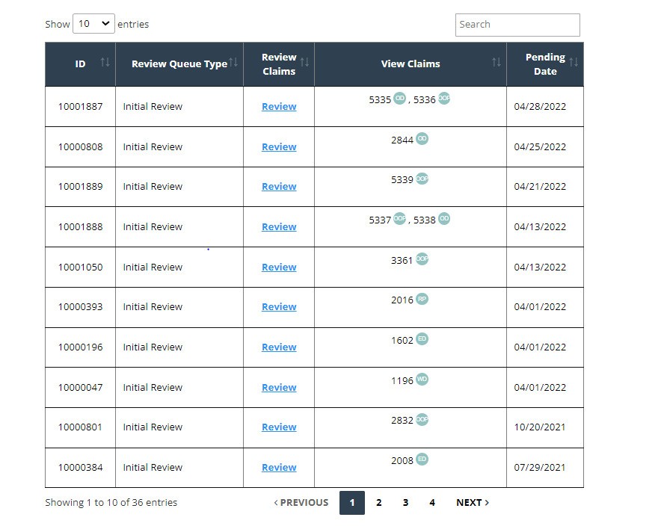
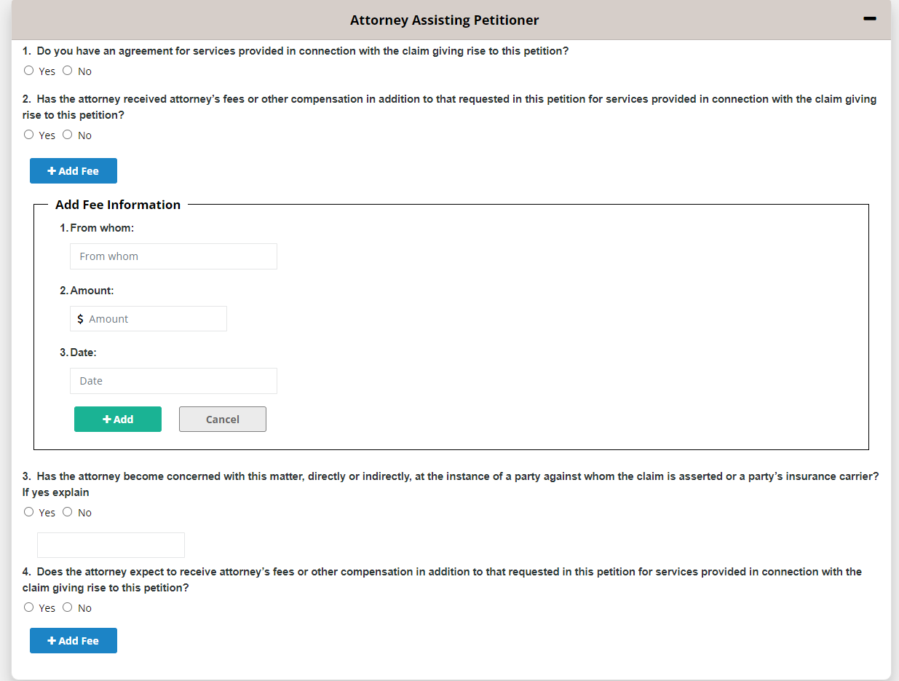
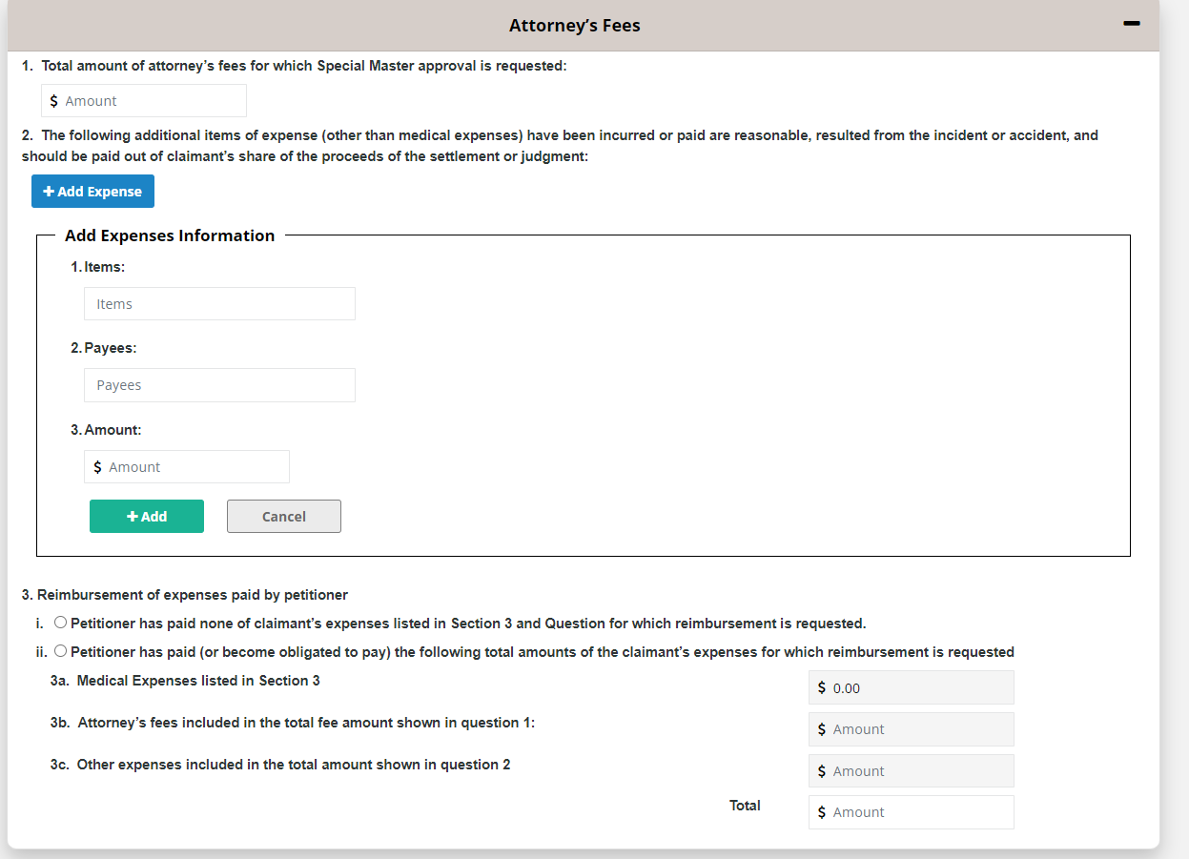
.NET – Web Forms in Web Application
Rakesh Chennareddy
NestorTechnologiesInc 15corporateplaces Suite#330 Piscastaway NJ08854
Introduction
The UI
Conclusions
Developed Web Forms in a web Application using asp.net as a Backend.
For the UI, used html, css and Java Script has been used.
Interacted with the teammates and manager over tasks and huddles.
Created a new functionality and a new web forms in an existing application with the use of asp.net.
Learned different technologies and programming languages like javaScript, css, c#, SSMS and MSVS.
Deployed the developed module through Jenkins.
Created and pulled the repositories by using the azureDevops.
TOOLS
Results
For the UI development, used Microsoft Visual Studio.
For the Database, used Microsoft SQL Server Management Studio.
Additional Resources
Acknowledgements
Poster Repository
https://code.visualstudio.com/
https://docs.microsoft.com/en-us/sql/ssms/download-sql-server-management-studio-ssms?view=sql-server-ver15
Dr. Cindy Tu (Program Instructor)
Sri Panyala (Manager)
Emmaneale Mendu (Team Lead)
https://github.com/Rakesh2697/Poster-presentation.git

